Slide 1
Coffee Chain Sales
Dashboard Summary

Slide 2
Key KPIs
Total Sales: 202,895.0
Total Profit: 411.0
Transactions: 1,062.0
Avg Ticket: 191.04990583804144
Profit Margin: 0.002025678306513221

Slide 3
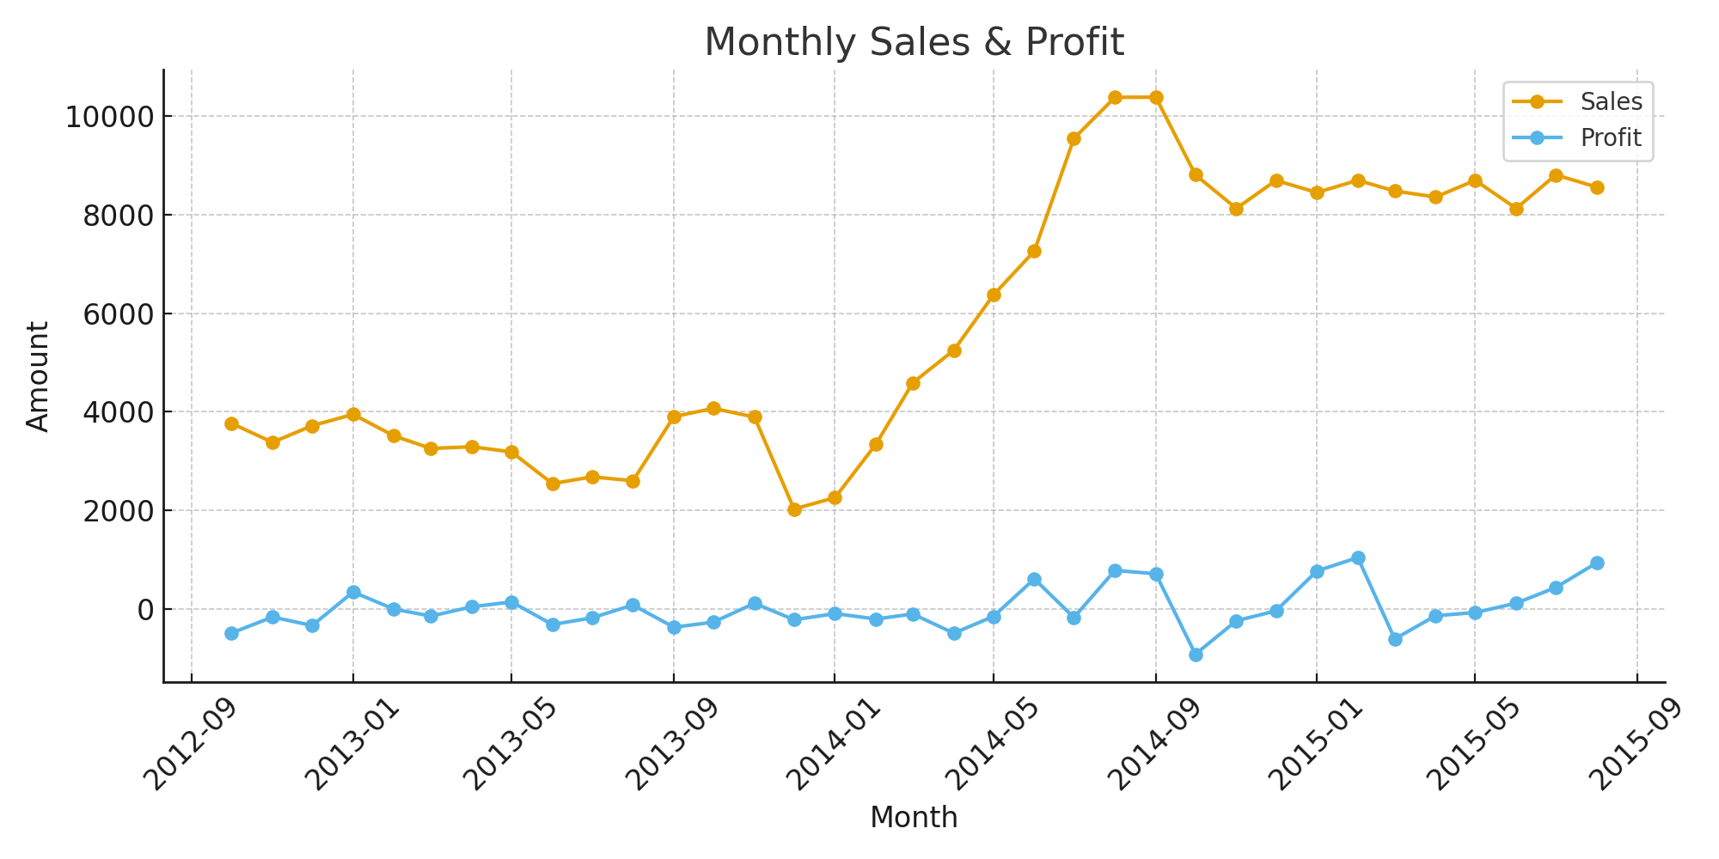
Monthly Sales Profit

Slide 4
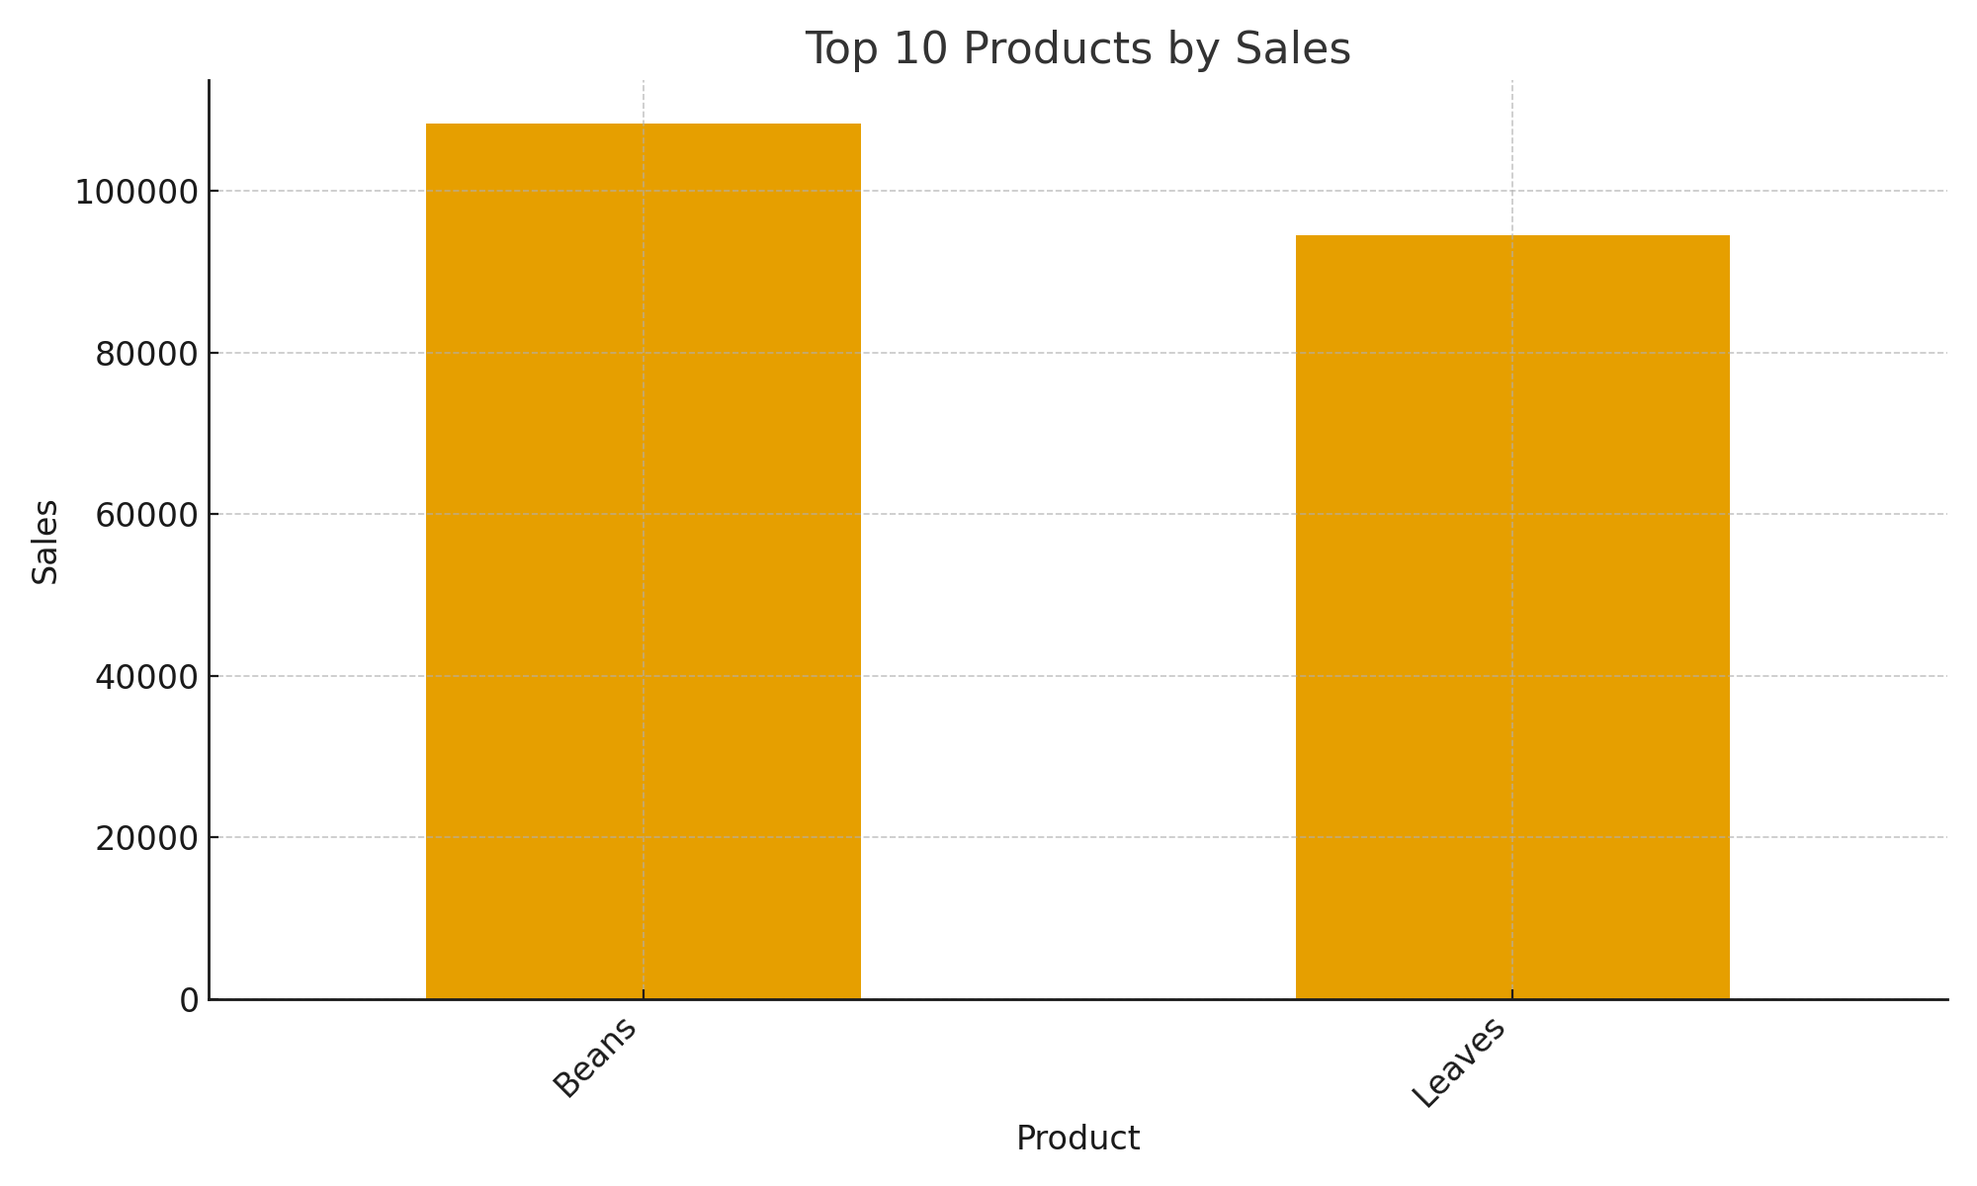
Top10 Products

Slide 5
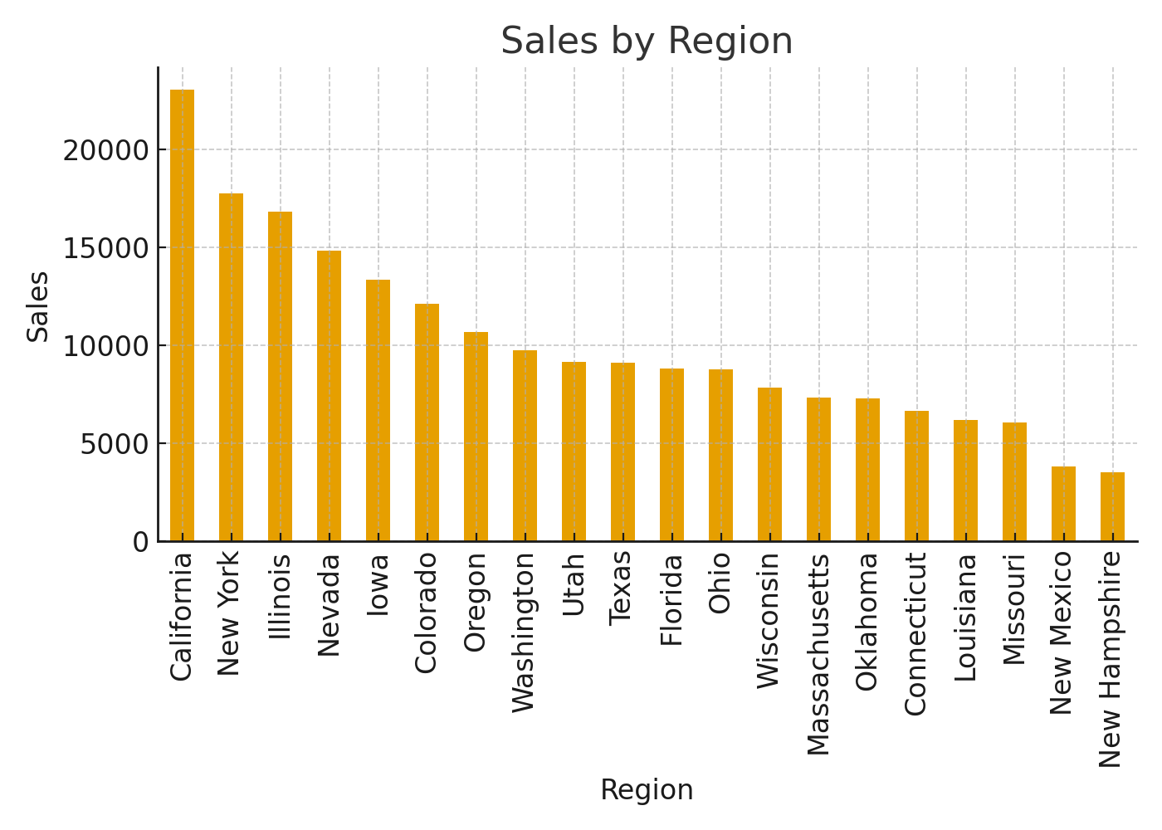
Sales By Region

Slide 6
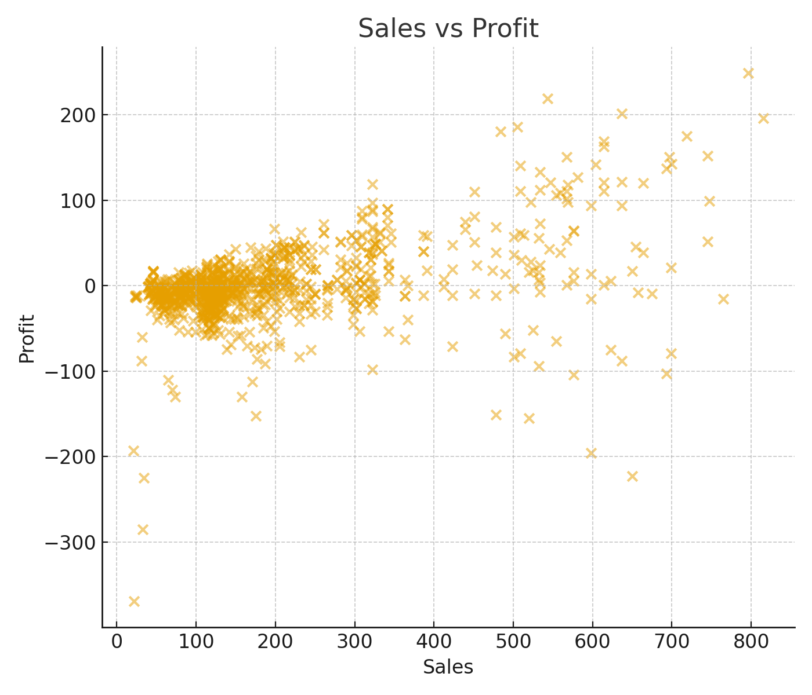
Sales Vs Profit

Slide 7
Actionable Insights & Recommendations
Key insights:
- Identify underperforming stores & run local promotions.
- Promote high-margin products & review markdowns.
- Create loyalty offers for top customers.
- Allocate inventory by region using slicer insights.
- Track MoM growth and set alerts for sharp drops.

Slide 8
Thank You …

